Slide 1
Agriculture & Food Security in the Context of
MDGs, Tanzania DV 2025, and SDGs
Imperatives for Improved Data, Information, and Policy Analysis for Food Security in SSA
REPOA Policy Forum, November 2015
Hyatt Regency,, Dar-es-salaam
Andrew E. Temu
Sokoine University of Agriculture

Slide 2
The presentation outline
Introduction: Ag. Dev. toward MDG1, TDV2025, and SGG 1-3
3. Key parameters for assessing performance
(A) Policies and Strategies: Translating Dev. Goals into Action
(B) Investment
  Public investment: Government Budget, investment and services offered
  Private sector investment: Commercial Finance and FDI
(C) Results
  GDP by subsectors: Agriculture, Forestry, Fisheries
  Productivity: Commodity, Labor, etc.
  Employment: population employed in agriculture
(D) Outcomes and Impacts: Meeting MDG 1, TDV 2015, and SDGs
  Welfare parameters: Poverty level trends
  Food security: Availability, Access, Sufficiency, Nutrition & Health indicators
4. Conclusion and recommendations
Notes:
Mgeni Rasmi – Katibu Mkuu Kiongozi
Engineer Nyamuhanga – Naibu Katibu Mkuu – Ministry of Works
Mweneykiti wa Bodi ya Wahandisi – Engineer Lema
Viongozi wa Serikali
Distinguished foreign delegates

Slide 3
(A) Internalizing Goals in Policies and Strategies
MDG1, SDG 1 to 3 & TD Vision2025
Policies & Strategies
MKUKUTA
Mini-Tiger Plan 2020
Long-Term Perspective and Five Year Plan
National Agriculture Policy ASDS
Programs and Projects::
ASDP 1 and II
Kilimo Kwanza
CAADP/TAFSIP,
FtF, SAGCOT, MIVARF etc
Investments:
Public funding
Private Sector Investments
Commercial Finance (Banks)
MDG1 Outcomes:
Food Self-sufficiency
Food Security
Nutrition
Poverty
Results and Outcomes:
Sector Growth
Production and Productivity
GOOD JOB Done
Notes:
----- Meeting Notes (03/09/15 12:04) -----
Remember National Irrigation Master Plan
In assessing the implementation, challenges could be at any level amongst these
My conclusions may point to challenges in planning, hence I have to be understood

Slide 4
MDG 1 to SDGs 1 to 3
MDGs: Achieved 2 – Education Enrollment and Maternal
SDGs have 17 goals and 169 targets.
15 Year Road Map: 1st January 2016 – 31st December 2030
Relevant here:
Goal 1: End poverty in all its forms everywhere
Goal 2: End hunger, achieve food security and improved nutrition, and promote sustainable agriculture
Goal 3: Ensure healthy lives and promote well-being for all at all ages

Slide 5
(B): INVESTMENT – data and information
  Public investment:
  Government budget, investment, and services offered
  Private sector investment:
  Growth in domestic and Foreign Direct Investment
  Commercial Lending to agriculture
  Proportion of commercial lending to agriculture

Slide 6
Government’s Agriculture Budget
Increased from 233bn in 2005/6 to 1,084.7bn 2014/15
Monitorable Data and Information
It is an increasing trend – commendable but inadequate
It is less than 1% of the GDP,
Less than the recommended 10% - CAADP
Development budget < 60%;
Disbursement – at times - as low as 20%

Slide 7
Domestic and FD Investment into Agriculture
Data and Information examples
1. TIC reckons 55% of Formal PS Investment in Agriculture is domestic
However: small, stagnant with low growth, drop-outs are common
2. Overall FDI is still below 5% of GDP
3. The business environment has a role to play to improve FDI
Example of Information: Investment Value per agriculture sub-sector

Slide 8
Commercial Lending to agriculture
Example of Information: Agriculture / Total Commercial Lending: In TSh Trillion
Notable useful information
Total commercial lending increasing, reflective of economic growth
Agriculture lending has never gone above 12.5% of Total commercial lending
Domestic investment is thus impaired
Commercial lending doesn't suit agriculture investment

Slide 9
(C) Results of Investments
Public and Private Funding which translates into:
  Agricultural Inputs
    Example: NAIVS – the most significant initiative
  Irrigation Infrastructure
    Example: Target 1Mn ha; achieved 430,000
  Extension Services
    Example: Approaching 1 extension worker/village
  Examples

Slide 10
Percentage of Farmers Using Fertilizer
NBS data
Area | %
 | <5
 | 5-15
 | 15-30
 | 30 - 60
 | >60
 | Lakes
 | No data
Solution to low levels of fertilizer and seed use – up to 2014
NAIVS program, accounting for 40% of MAFSC budget
Well promoted fertilizer & seed – in the southern highlands
Riddled with governance shortfalls
Seed demand 120,000 tons, supply is at around 28,000 tons
Fertilizer Use 9kg/ha - V/S - 27kg/ha Malawi, 365kg/ha China

Slide 11
Irrigation Investments
Irrigation Indicator | 2006/07 | 2010/11 | 2013/14
Area under Irrigation [ha] | 273,945 | 399,755 | >430,000
Growth rate of area under irrigation [%] |  | 22.4 | 7.5
The Challenge: A very low investment to cover potential area
Areas irrigated very small compared to potential
- High potential, feasible investment: 2.3 million ha
- Area developed 430,000
Climate change & Env. interplay to challenge irrigation
- Climate change impacts weather and rainfall patterns
- Irrigation investment calls for good management and EIA

Slide 12
Agricultural Extension Services
Extension Challenges
Target: One extension officer per village
Total Demand translates to: 15,082 extension staff
To-date: Number increased from: 7,974 in 2005
to: 10,520 in 2014 [i.e. employed 2,546]
Additional Challenge:
The effective methodology to use: T&V, FFS, FTF, etc. – context specificity

Slide 13
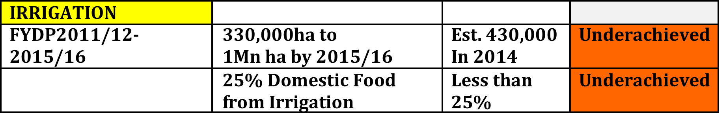
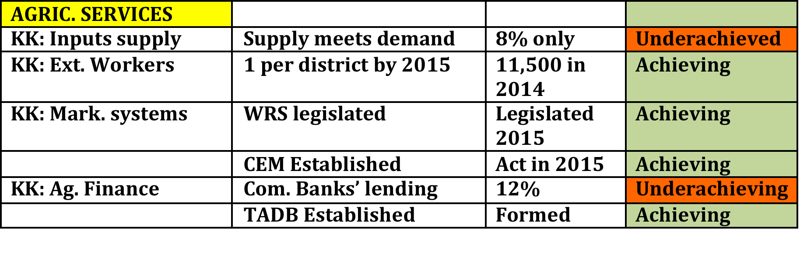
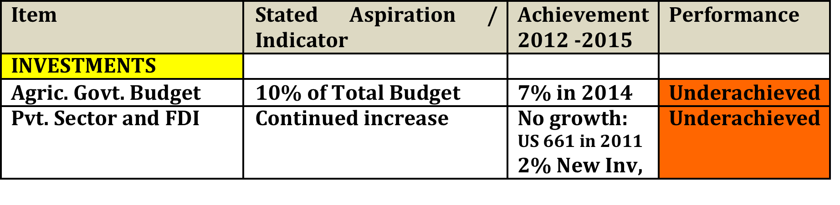
Summary: Investment & Services: Budgets, Irrigation, & Services

Slide 14
(D) Outcomes and Impact:
(a) Productivity and growth
(b) Poverty and Food Security
1. Productivity and growth
2. Poverty: Basic Needs, Income, MPI, etc.
3. Food Security: Availability, Access, Utilization, & Stability
  Food energy availability
  Quality of dietary intake
  Nutrition indicators
  Expenditure on food
  Household and community coping strategies
  Examples:

Slide 15
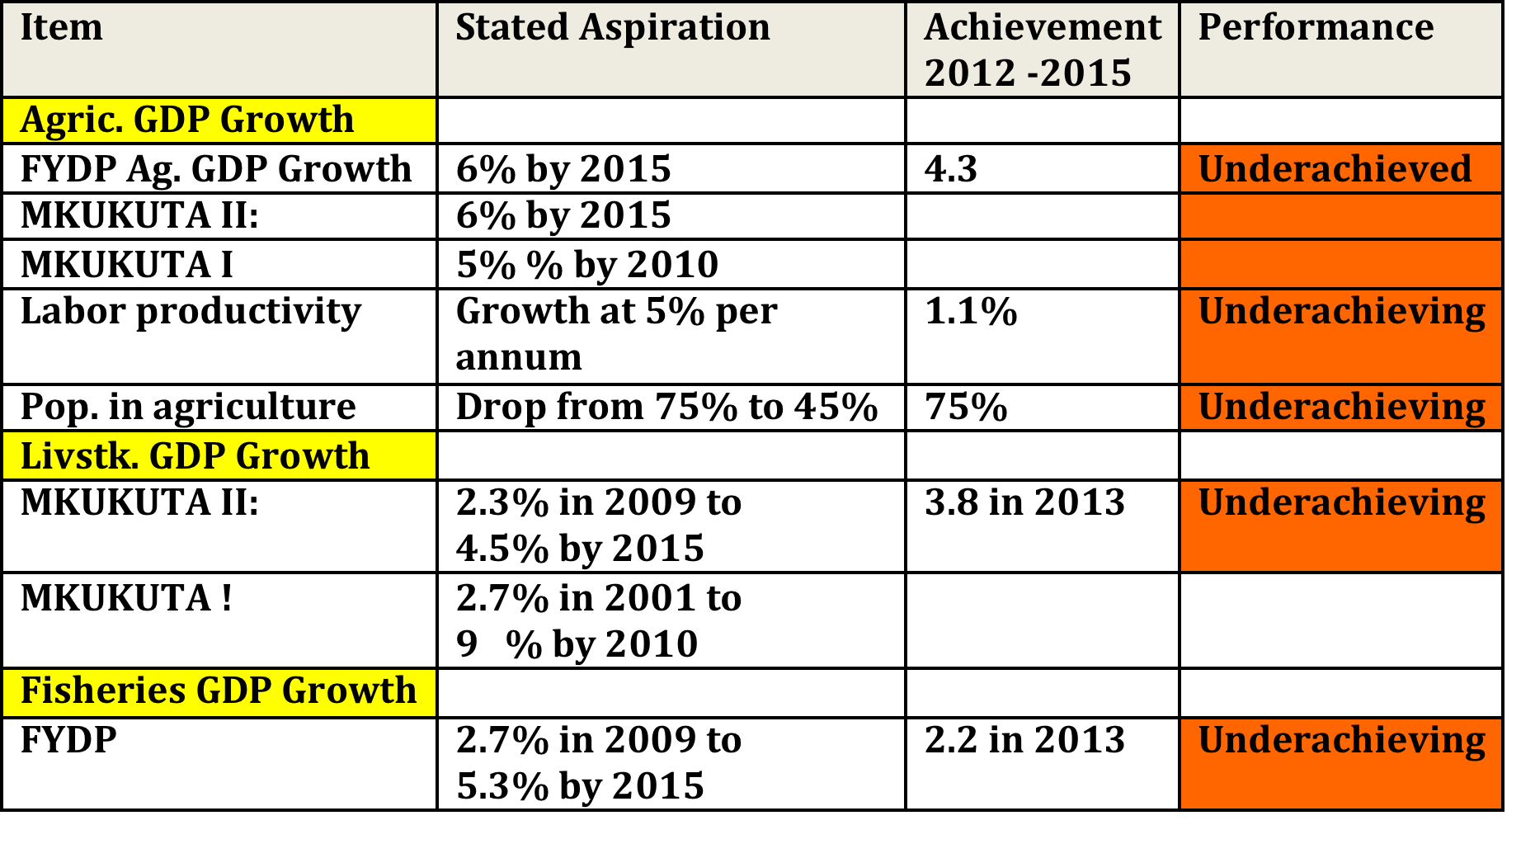
Outcomes: Productivity and Growth

Slide 16
Impact
Poverty Trend: NBS’s Household Budget Survey
YEAR | Poverty HBS data estimates [%]
2001 | 35.6
2007 | 33.4
2012 | 28.2
2015 | [?]
Did not reach 12.5% by 2015 as per MKUKUTA
Poverty continues to be a rural phenomenon
Agriculture is at the heart

Slide 17
Impact: Food Security Indicators

Slide 18
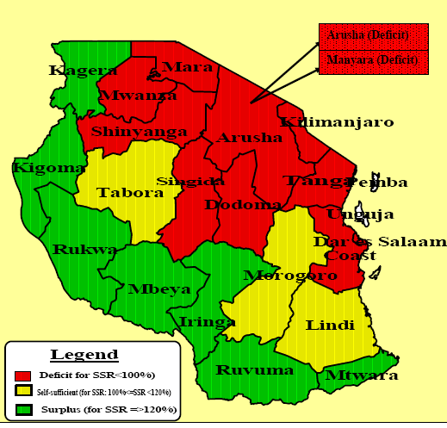
Geographical Imperatives: Regional Differences in FSS
Notes:
Within the same year food shortages, insecurity, and nutrition problems in certain geographical location of the country are a more thorny challenge. Principally these result from more fundamental factors that need to be addressed to achieve a more sustainable food security situation: localized climatic conditions rendering some geographical areas as perpetual deficit zones; poor infrastructure linking surplus production regions and deficit; weak household entitlement and low incomes. Therefore aggregate country’s food security and nutrition, and food poverty, are influenced by more factors than just surplus production is some areas.

Slide 19
Impact: Child Nutrition Security [6 to 59 Months]
Year | Stunting (Height for Age below SD) % | Underweight (For Age below 2 SD) % | Wasting (Wasting for Height for age below 2 SD) %
1999 | 44 | 29.5 | 5.3
2005 | 38 | 21.9 | 3.7
2010 | 42 | 16 | 3.8
FAO – 2013. MAFAP Study

Slide 20
Impact: Children and Women Health Challenges
Children Under 5 years | % |  | Women | %
Stunting | 42 |  | Low body mass index | 11
Underweight | 16 |  | Iodine Deficiency | 36
Anemia | 72 |  | Anemia | 40
Iron Deficiency | 35 |  | Iron Deficiency | 30
Vitamin A Deficiency | 33 |  | Vitamin A Deficiency | 37
FAO – 2013. MAFAP Study

Slide 21
Are We on Target?
We are not on target!
Nature of Econ. Transformation taking place (a) Isn’t as per TDV2025,
(b) Did not meet MDG,
(c) Speed and depth is low to address SDG

Slide 22
RECOMMENDATIONS:
Examples where data and information should point to
Increases in public funding, i.e. Government Budget, especially Dev.
  Strike the 10% ; improve performance in disbursement
Improvement business environment, encourage Pvt. Sector in Agric.
  Examples:
  Address land issues,
  Rationalize taxes,
  Prudently manage importation of competitive commodities
Reviews of prudent financial sector regulations for agriculture:
  Exposure limits,
  Securitization,
  Appraisal standard

Slide 23
RECOMMENDATIONS:
Examples where data and information should point to
Up-scaling of proven agricultural transformation models:
  Up-scale the SAGCOT anchor investor & contract farming arrangements
  Strongly denounce activists against agriculture commercialization
Developments of the land market:
  Land Titling and Recording Land Transactions
Promotion of Regional Agricultural Exports from Tanzania:
  Enhance agro-processing: Provide Tax and Other Fiscal Incentives
Improvements in planning and various strategy execution
  Data is critical, e.g. Forestry and natural resources data in general

Slide 24
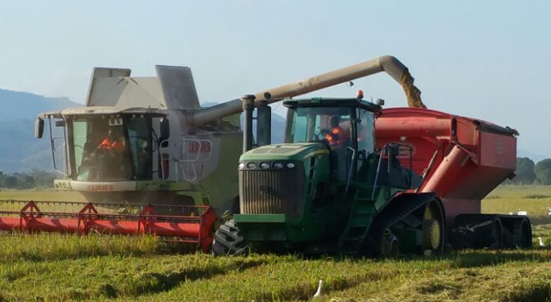
Ahsanteni

