Slide 1


A New Landscape for Food Security: Challenges for Zambia
Maximo Torero
and Teunis van Rheenen (m.torero@cgiar.org)
Policy Dialogue on Food Security and Nutrition Situation in Zambia
Theme: Enhancing the Link between Evidence and Agriculture, Food and Nutrition, Tuesday, 8th December 2015, Government Complex, Lusaka, Zambia

Slide 2

GLOBAL CHALLENGE
Growing
Human Pressure
Ecosystem decline
Climate change
Surprise
Source: Johan Rockstrom: Let the environment guide our development

Slide 3

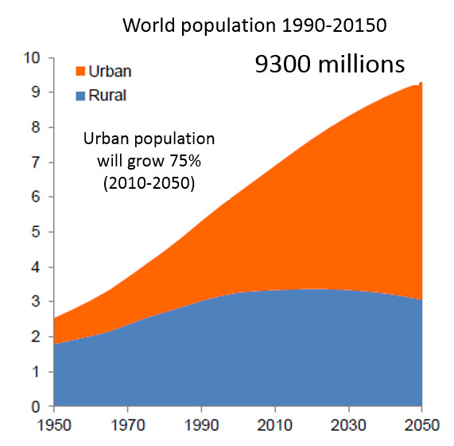
POPULATION GROWTH
Bigger population in urban areas will demand more and better food
Change in population by region 2010-2100 (millions)
-63 millions
182 millions
432 millions
2,552 millions
97 millions
29 millions
36%
Africa: Younger
Asia and Europe: Older
Source:UN 2011

Slide 4
Slow decline in malnourishment.
Alarming increase in obesity.
Africa
Asia
Developing Countries
Africa
Asia
Developing Countries
Undernourished people (millions)
Stunted children (millions)
Overweight & obese children (millions)
Source: UN in de Onis, M, M. Blössner and E. Borghi. 2010. Global prevalence and trends of overweight and obesity among preschool children. American Journal of Clinical Nutrition 92:1257–64. (http://www.who.int/nutgrowthdb/publications/overweight_obesity/en/).
Source: FAOSTAT3 (http://faostat3.fao.org/download/D/FS/E).
Source: de Onis, M, M. Blössner and E. Borghi. 2011 http://www.who.int/nutgrowthdb/publications/Stunting1990_2011.pdf.

Slide 5
WATER STRESS RISK
By 2050
Total population living in water
scarce areas
36%
39%
22%
population
grain production
global GDP
52%
49%
45%
4.7
BILLION PEOPLE
90%
TODAY
Total population living in water
scarce areas
Global GDP generated in water scarce regions
2.5
BILLION PEOPLE
US$63
TRILLION
Global GDP generated in water scarce regions
US$9.4
TRILLION
570%
Source: Veolia Water & IFPRI 2011.

Slide 6
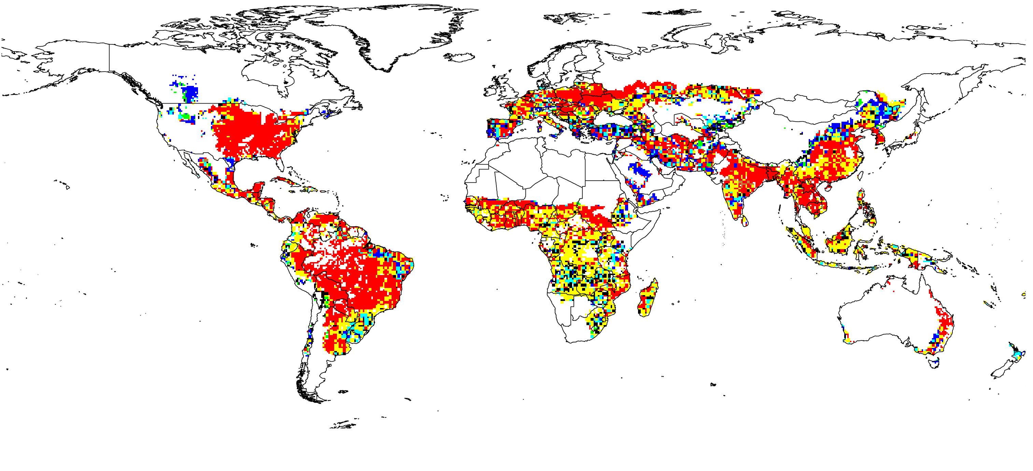
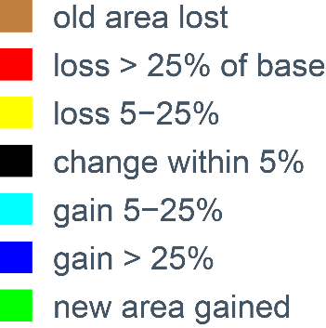
HEAVY TOLL ON RAINFED MAIZE WITH CLIMATE CHANGE
Global yields projected 30% lower in 2050 compared to no climate change
(HadGEM2, RCP 8.5)
Source: IFPRI IMPACT simulations.

Slide 7
FOOD PRICES INCREASE WITHOUT CLIMATE CHANGE; EVEN HIGHER WITH CLIMATE CHANGE
No climate change
Average with climate change
With climate change - range across models
2010 = 1
(Indexed to 1 in 2010)
2010 = 1
Cereals
Roots/tubers
Source: IFPRI IMPACT 3.2 Projections.

Slide 8
Per capita food consumption grows.
Africa and South Asia catching up.
Sources: 1969-71 to 1999-2001 from Alexandratos 2006; 2010-2050 from IFPRI's IMPACT 3.2 Projections.

Slide 9
Improved progress on hunger, but too slow.
Climate change increases hunger.
Undernourished people (millions)
Developing countries
South Asia
Africa south of the Sahara
Source: IFPRI IMPACT 3.2 Projections.

Slide 10
A continuous trend towards internationalization of food markets
19.1%
18.2%
16.1%
13.9%
12.3%
1975
1985
1995
2005
2015
Share of produced calories crossing an international border

Slide 11
Evolution by region of the price support through border measure
Notes:
I have eliminated the “absolute” indicator to simplify the picture

Slide 12
Africa in Global Trade
After the long decline of the ‘70s-’90s, a reversed trend:
In 15 years, total trade for SSA has been multiplied by 6, agricultural trade by 4.6.
In comparison, global trade multiplied by 3.4 and agricultural trade by 2.9.
Notes:
Exports + o,[prts. Billion nominal
No official data for 2014

Slide 13
Heterogeneous Performance on Global Agricultural Markets
Explaining a country’s performance and defining the right benchmark:
Being specialized in the right products?
Being specialized in the booming markets?
Improving its own competitiveness?
During this period, exports have:
decreased by 20 M USD for C.A.R (bad performance in absolute and relative terms).
increased by 150 M USD for Uganda (bad performance in relative terms).
increased by 88 M USD for Rwanda (good performance in absolute and relative terms).
Source: Bouet, Deason and Laborde (2014)
Notes:
Sector: sectoral = global demand for my product evolve relative = gray I am loosing share so selling products the world is not looking for
Geographical= they are booming market for example from Niger is selling to Nigeria because of oil boom, same thing when you are selling to China.
The net effect is sum of blue and organge so Nigeria is not performing properly
Domestic performance, due to structural reform they manage to eport more, in this case they are selling coffee
Blue you increase market share because you are doing something on your own, in Rwanda is after war.
CAR Central Africa

Slide 14
Implications of Changing Prices and Demand for Energy and Food
Need to differentiate short term variation and medium/long term modification of the trend.
Different policy responses on both energy and agricultural, and macroeconomic policies.
In SSA, weak institutions, capital, financial and insurance markets: incremental costs of volatility.
Energy and food prices: high level of distortions, and huge heterogeneity of policies within the continent.
From energy to food prices: many links (inputs, fertilizers, transports, biofuels).
Notes:
(HS Code) CEMAC ECOWAS COMESA Rwanda SACU 1006.20.00 Rice 5% 10% 0% 75% 0% 1001.10.90 Wheat 10% 5% 0% 0% 0% 0714.90.10 Yams 30% 20% 0% 25% 5% 0201.10.00 Beef (carcass) 20% 35% 0% 25% 40% 0207.11.00 Chicken (cuts) 5% 35% 0% 25% 27% 0402.10.00 Milk Powder 5% 20% 15% 60% 96%

Slide 15
Looking at the Past
Increased regional integration, especially when looking at the nutritional contents of trade flows.
Shift in external suppliers among Americas.
Role of African intra-trade over the previous decade has more than doubled.
1/3 of the calories exported by Africa, go to Africa
Source: Bouet, Deason and Laborde (2014)

Slide 16
How Will Intra-African Trade Perform?
Under a business as usual scenario? +122% in average
Which levers could we use to reach the CAADP target (+200% from 2014 to 2025, Malabo Declaration)?
  Addressing trade policy barriers
  Improving infrastructure
 | CEMAC | COMESA | ECOWAS | SACU
CEMAC | 67% | 148% | 80% | 88%
COMESA | 148% | 146% | 179% | 116%
ECOWAS | 80% | 179% | 136% | 137%
SACU | 88% | 116% | 137% | 111%
Source: MIRAGRODEP model simulations, Bouet, Deason and Laborde (2014)
Notes:
CEMAC =central Africa
COMESA positive
Ecowas is moving to negative see slide before

Slide 17
Trade Policy Barriers for Expanding Trade in Africa
Despite regional integration, intra-African trade still affected by:
significant tariffs;
the need to address between trade barriers between blocs;
external pressure to liberalize markets with third countries (EPA with the EU: SADC and ECOWAS should sign this year);
instability/uncertainty regarding some trade policies
Huge potential for an ambitious trade facilitation agenda:
Free circulation of goods still not achieved within custom unions (intra-trade still affected by MFN tariffs, double taxation, etc.)
Numerous fees and bribes
Administrative burden
Inefficiency of checkpoints (delays)
Notes:
He will send examples of variance.
The regions need to build their common tariff but they have not implemented
Also they are signifying agreement with Economic partnership agreement.
(HS Code) CEMAC ECOWAS COMESA Rwanda SACU
1006.20.00 Rice 5% 10% 0% 75% 0%
1001.10.90 Wheat 10% 5% 0% 0% 0%
0714.90.10 Yams 30% 20% 0% 25% 5%
0201.10.00 Beef (carcass) 20% 35% 0% 25% 40%
0207.11.00 Chicken (cuts) 5% 35% 0% 25% 27%
0402.10.00 Milk Powder 5% 20% 15% 60% 96%

Slide 18
ADDITIONAL DEMAND FOR BIOMASS
Growing population
Growing income
Need for alternative to fossil carbon chains

Slide 19
GROWING DEMAND
Increase in yield and area, extension of cropland, and reduction of other crops
Additional food demand
Increased
production
Additional Bioenergy demand
New Demand
for crops
Reduced supply
for final consumers
Hunger?
Substitution effects
Additional industrial
Feed
Other sectors (agrifood, cosmetics)
Substitution effects
Reduced supply for
intermediate consumers
Biomass demand

Slide 20
Challenge 1: Improve efficiency or shift of potential frontier

Slide 21
Production of key crops, in Zambia, 1990-2013
Source: http://faostat3.fao.org

Slide 22
Food supply per capita per year, Zambia, 1998-2010
Source: FAO 2015

Slide 23
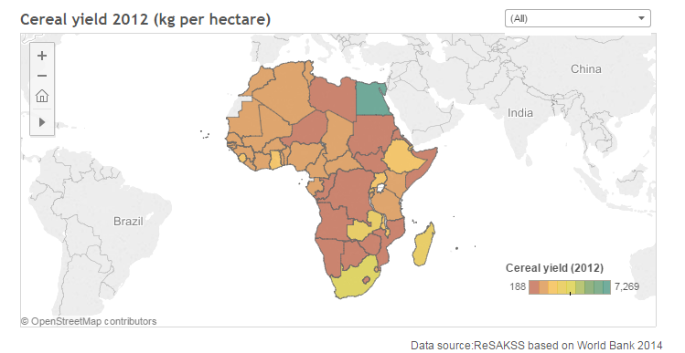
Yields are still low

Slide 24
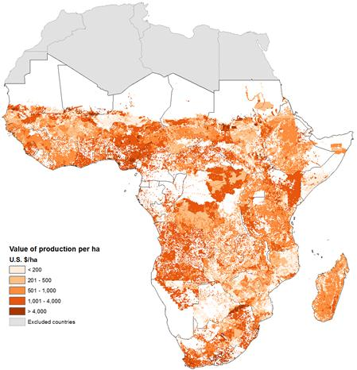
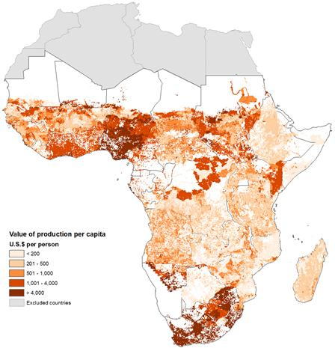
Spatial Patterns (annual avg. 2005-07)
Land
Labor
Source: Benin, et.al (2011). Trends and Spatial Patterns in Agricultural Productivity in Africa 1961-2010, ReSAKSS.

Slide 25
Intensity of agricultural research spending and capacity, 1981–2008
Notes:
Long-term trends indicate a serious decline in investment in agricultural R&D in Zambia. Public agricultural R&D spending fell to an historical low of 18 billion kwacha or 7 million PPP dollars in 2005 (both in 2005 constant prices), compared with 52 billion kwacha or 22 million PPP dollars per year on average during the 1990s. Although expenditures recovered slightly in 2007, spending was still low in 2008. The combined efects of a government-sector hiring freeze and lack of training opportunities resulted in signiicant erosion of research staf capacity. Although staing levels increased to 209 FTE researchers in 2008, the composition shifted towards junior rather than senior researchers, meaning those holding BSc rather than PhD degrees. ZARI was particularly afected by a reduction in the number of PhD-qualiied researchers. In addition to training and capacity limitations, ZARI and the other government research agencies have also faced challenges in supporting the operating and capital costs associated with research. A number of needs have been identiied at ZARI, such as infrastructure, laboratory equipment, communication facilities, and vehicles. Delays and reductions in the disbursement of budgeted funding from both the national government and foreign donors continue to constrain the eicient management of research funding. Although GART has been successful in generating funding through the sales of goods and services, as well as attracting donor funding and strengthening linkages with UNZA, other trusts within the nonproit sector have not fared as well. They were originally created for the purpose of increasing the lexibility and eiciency of research funding and management, in addition to promoting public–private partnerships. They, however, still depend on national government funding and have yet to meet the expectations of their mandate. Although the recent rise in the number of agricultural researchers is positive—as is the upgrade of ZARI to a ministerial department, and increased investment under ADSP since 2007— Zambia’s agricultural R&D agencies are still contending with the efects of long-term underinvestment and continue to struggle with funding issues that hinder their ability to contribute more efectively to the country’s agricultural and economic development.

Slide 26
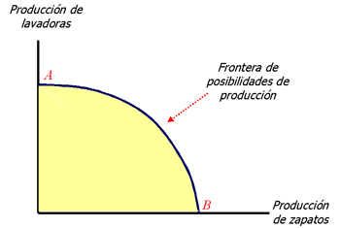
Stochastic Profit Frontier
Production of maize
Frontier of possibilities of production increases
Frontier of possibilities of production
C
Production of wheat

Slide 27
Challenge 2: We need to be resilient to climate change and weather shocks

Slide 28
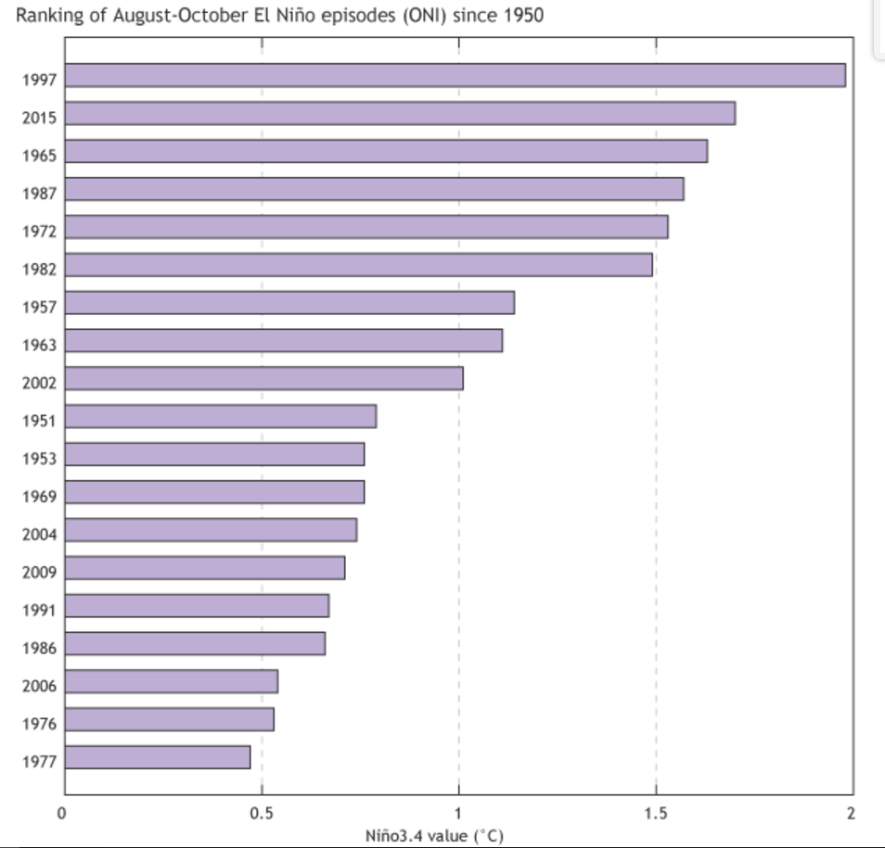
El Niño Risks
Ranking of August-October El Niño episodes (ONI) since 1950
https://www.climate.gov/news-features/blogs/enso/november-el-ni%C3%B1o-update-it%E2%80%99s-small-world
Notes:
Ranking of August-October El Niño episodes (ONI) since 1950

Slide 32
El Niño Risks
The strongest ever El Niño heat waves were predicted to hit parts of Southern Africa towards the end of 2015 and lasting through to 2016.
According to The 19th Southern African Regional Climate Outlook Forum (SARCOF-19) there will be insufficient rainfall during the forthcoming agricultural season that runs from October 2015 to March 2016
This comes at a time when the Kariba Dam between Zambia and Zimbabwe is experiencing declining water levels. Water levels in Lake Kariba have dropped to 41 percent compared with 80 percent this time last year.
With El Niño forecast to continue into the first quarter of 2016, suppressed rainfall is likely. This will affect Zambia which is a region where maize supply is already well below the five-year average and acute food insecurity is already more severe than usual,
An equivalent episode of drought in 1992 cost the Zambian government US$ 300 million and translated into a 39 percent drop in agricultural output and a 2.8 percent decline in the country’s GDP.

Slide 33
Challenge 3: Economic Growth is not enough-huge challenge in poverty and nutrition

Slide 34
Poverty levels and income per capita, Zambia, 1990-2014
Source: World Bank 2014

Slide 35
Share of total public expenditure allocated to the agricultural sector, Zambia 2000-2009
Source: AGRA 2013

Slide 36
Share of the population below minimum level of dietary energy intake (official MDG indicator), Zambia, 1991-2013
Source: United Nations Statistics Division 2014

Slide 37
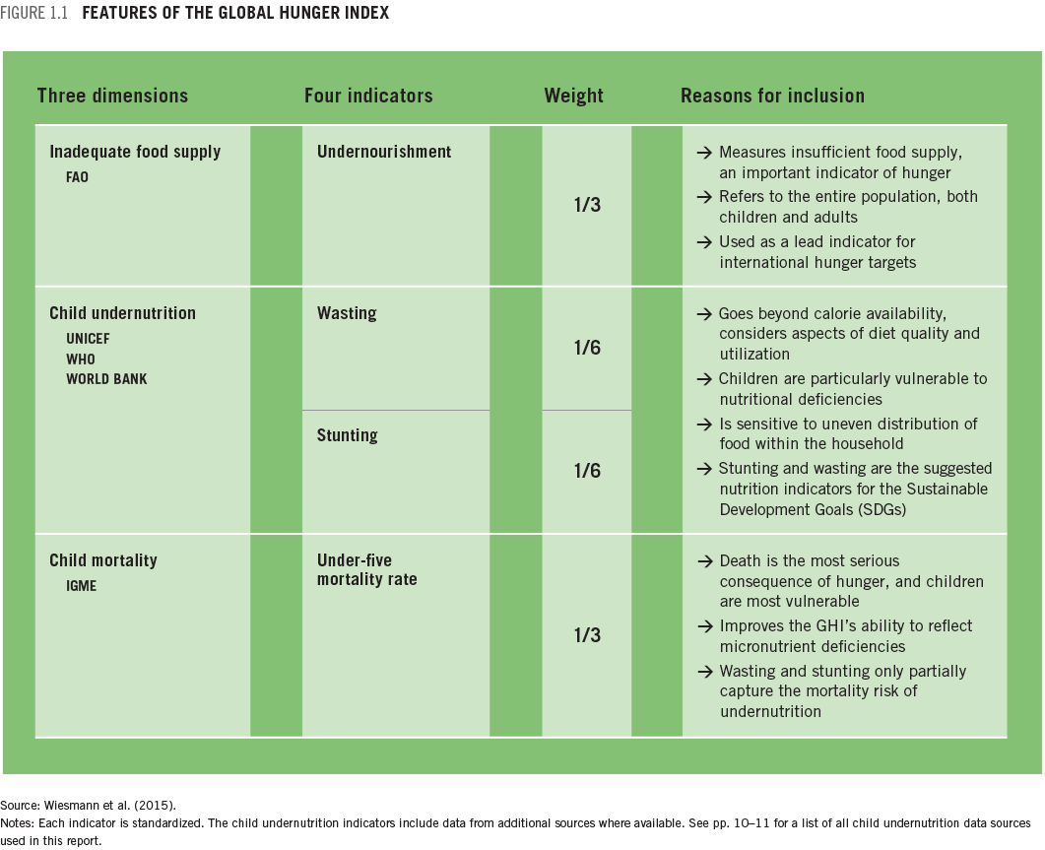
GHI measures three dimensions of hunger

Slide 38
Different types of childhood malnutrition (abstract)

Slide 39
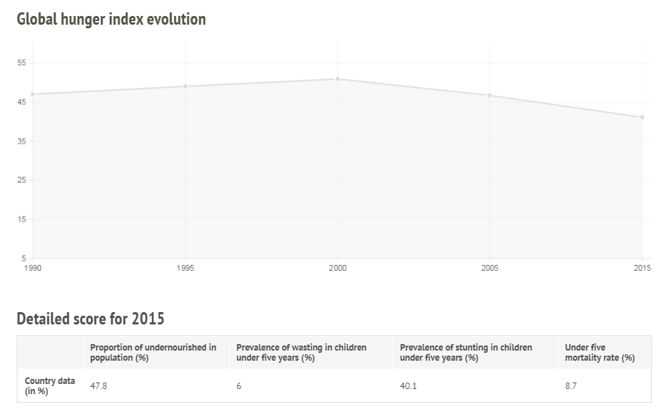
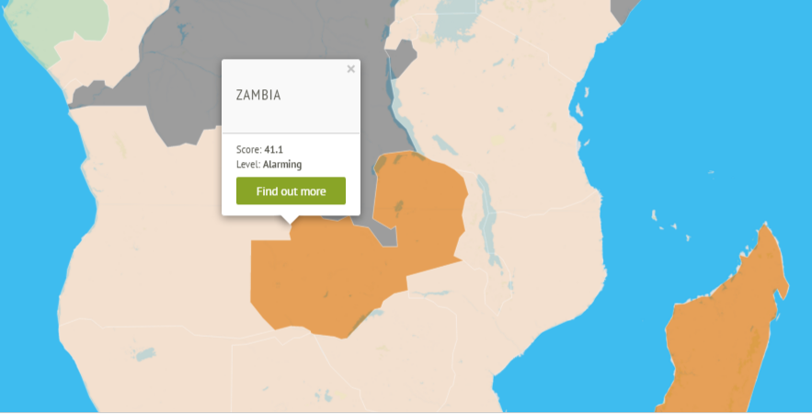
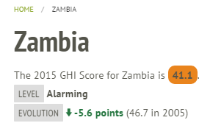
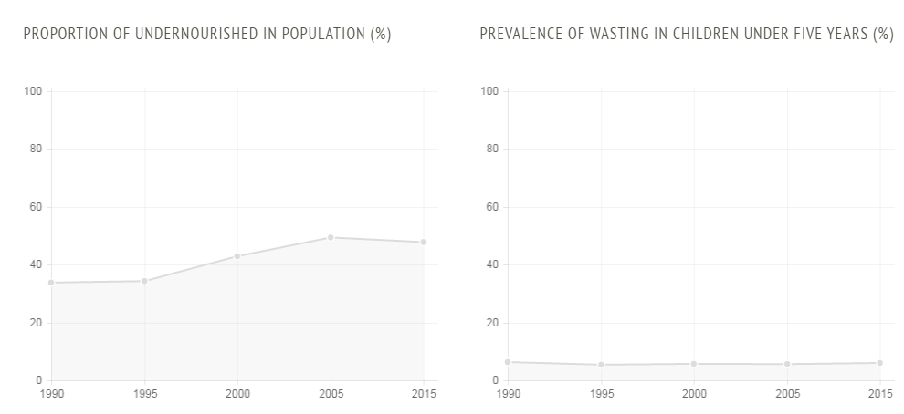
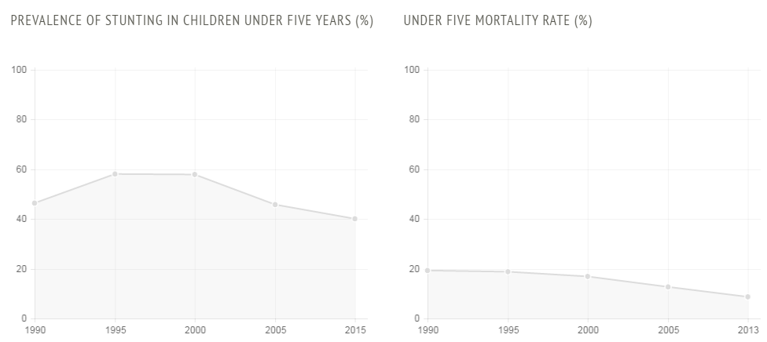
GHI severity scale
50.0 ≤
extremely
alarming
≤ 9.9
low
10.0-19.9
moderate
20.0-34.9
serious
35.0-49.9
alarming

Slide 40
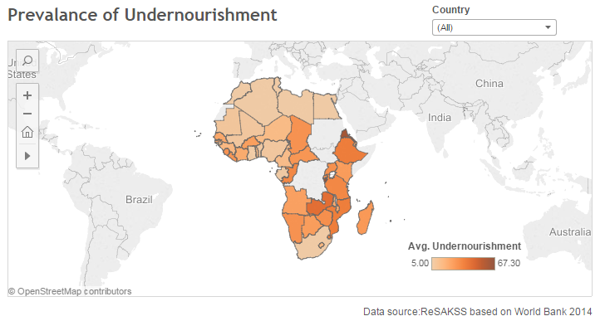
Prevalence of Undernourishment

Slide 41
Food Supply

Slide 42
Water and Sanitation

Slide 43
Final Remarks

Slide 44
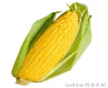
Important changes in key drivers
Huge opportunity
Agriculture is critical for
Employment
Land constraints
Gains in efficiency and potential
Economic development
Trade
Sustainable Agricultural Intensification (SAI)
Food & nutrition Security
Climate change
Increase value added & enable environment
Needs to be inclusive
But we need proper regulatory environment
Demand drivers changing rapidly

Slide 45

Features
SSA.foodsecurityportal.org

Slide 46
Main Features
Policy network
Volatility & Early warning systems
Policy research networks associated with AGRODEP in Africa south of Sahara
volatility of local prices and of relevant commodities
Media analysis tools
Covering regional major crops including maize
Themes and discussion
Thematic topics (food access, food availability, input markets, risk and resilience, food consumption and nutrition)
Soil profiles
Soil grid map application collaborated with SoilGrids.org
Crop and Yield mapping
Crop calendar application collaborated with GeoGlam initiatives and yield mapping.
Agricultural R & D indicators
on institutional, investment, and capacity trends in agricultural R&D.

Slide 47
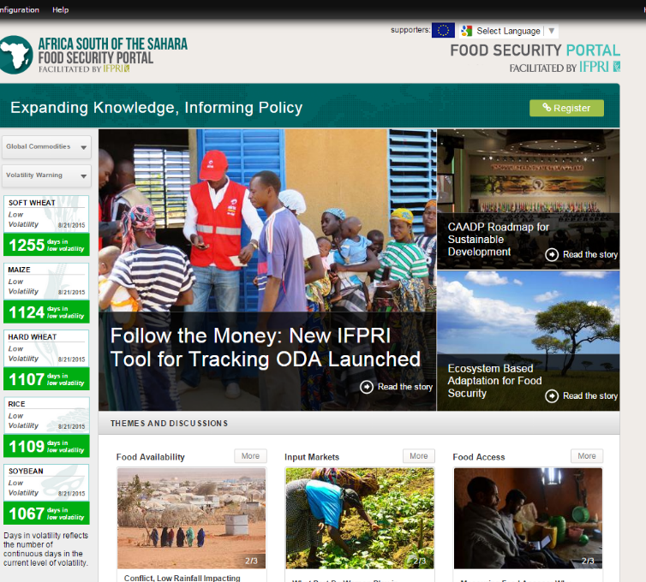
Volatility warning
Visual representation of historical periods of excessive global price volatility from 2000-present, as well as a daily volatility status.
Prices
Monthly and weekly commodity prices of hard wheat, soft wheat, maize, rice and soybeans and daily futures prices
Early warning system
Global information and early warning system (GIEWS) and Famine Early Warning Systems Network covering east, west, and south Africa
GOAL is and Early Warning Dashboard of indicators

Slide 48
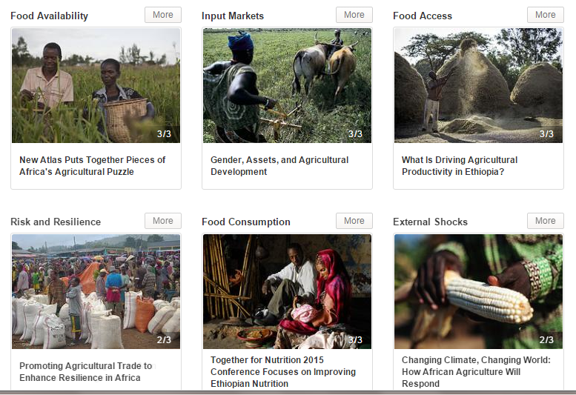
Themes and Discussion

Slide 49
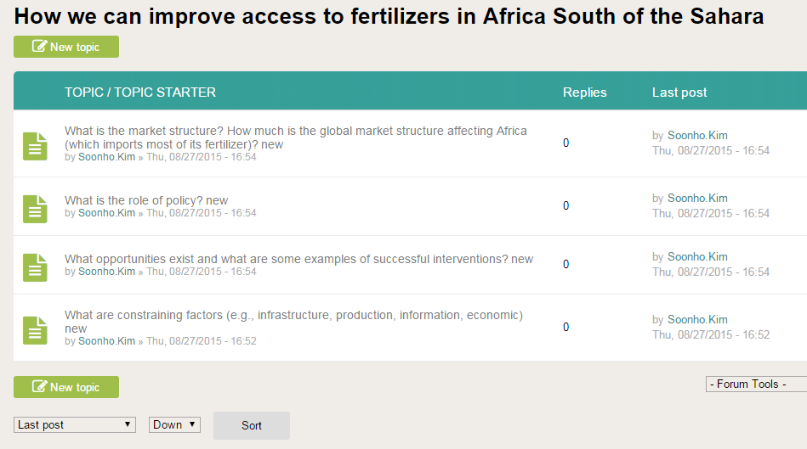
Virtual Dialogues

Slide 50
Thanks!

