Slide 1
Agricultural Interventions for Small and Medium Scale farmers in Zambia:
Opportunities and Challenges for Food and Nutrition Security
Rhoda Mofya-Mukuka
Presented at A Policy Dialogue on Food and Nutrition Situation in Zambia. December 2015. Lusaka.
Indaba Agricultural Policy Research Institute

Slide 2
Objective
Identify current interventions in Zambia’s agricultural sector
Examine bottlenecks and opportunities associated with the intervention

Slide 3
Focus
Interventions targeted at improving agricultural growth among Small and Medium-scale Farmers
Public-private and public interventions (or activities)

Slide 4
Why intervention strategies
Poverty reduction
Agricultural growth
Agricultural interventions
Food and Nutrition security
Outcomes influence by:
Policy,
Institutional and political frameworks.

Slide 5
Interventions currently in place
Social Protection
Social Cash Transfers
Nutrition
The First 1000 most critical days
Agricultural Productivity and Market Enhancement Program (APMEP)
Input subsidies and Rural Finance
Farmer Input Support Project (FISP)-includes e-voucher pilot.
Rural Finance Expansion Program (RUFEP)

Slide 6
Interventions currently in place
Irrigation
Smallholder Irrigation Promotion Program (SIPP)
Irrigation Development Support Program (IDSP)
Rural Infrastructure and Water development
Cashew Infrastructure Development Project (CIDP)
Zambia Water Resources Development Project

Slide 7
Interventions currently in place
Agribusiness interventions
Smallholder Agribusiness promotion program (SAPP)
Agricultural Productivity and Market Enhancement Program (APMEP)
Food Reserve Agency (FRA)
Conservation Agriculture
Conservation Agriculture Scale-up(CASU)
Conservation Farming Unit (CFU)

Slide 8
Interventions currently in place
Production and productivity interventions
Smallholder Productivity Promotion Program(S3P)
Agricultural Productivity Program for Southern Africa (APPSA)
Livestock development interventions
Livestock Infrastructure Development and Animal Health Project (LIDAHP)
Livestock Infrastructure Support Project (LISP)
Enhanced Sustainable Livestock Investment Program (E-SLIP)

Slide 9
Who are the custodians of the interventions and who is funding the intervention?
90 % implemented under the Ministry of Agriculture and Ministry of Livestock
Targeted at smallholder farmers especially women and some target youths
Coverage area
Most are national programs
Some target specific districts

Slide 10
Project period, budgets and funders
Project period ranges between 3 and 7 years
Budget ranges between US 20 million and US 200 m
Loans and grants: World bank, ADB and IFAD and other development partners.
GRZ also contributes to project funding.

Slide 11
What are the concerns and bottle necks around the ongoing interventions?

Slide 12
Lessons from past interventions
Higher project costs than budgeted (inflation, exchange rate volatility)
Lack of ownership by recipients and implementers
Delays in implementation due to late procurement of goods and services
Poor supervision of some project areas due to failure to include all weather roads at the design stage.
Mismatch between intended goals and actual outcome
Reduced effectiveness in achieving intended goals

Slide 13
Concerns from current projects
Erratic and untimely release of funds to the project areas.
Delays in implementation due to lengthy procurement procedures and staffing.
Lack of/poor exit strategy. Poor project sustainability.
Low adoption rates e.g. conservation agriculture
Conflicting goals across the interventions
Inadequate and unreliable data and untimely reports from the field.

Slide 14
Other specific concerns
VAT on processed products not refunded – threatens viability of agro-processing interventions (e.g in cassava processing)
Government’s direct participation in the market distorting prices and crowding out private sector
Wrong project/program recipients
Zambia has no aflatoxin level regulation for groundnuts

Slide 15
What are the opportunities for agricultural growth from interventions?

Slide 16
Interventions opportunities….
Result Oriented
Specific time frame
Goals that can be measured
Capacity building of project staff and recipients
Targeted recipients
Availability of funding

Slide 17
How can we improve performance of future interventions?

Slide 18
How to improve performance of future interventions
Problem of delays in project implementation
Establish a legal unit within the ministry
Capacity building of lower project staff
Inflation or exchange rate problems –
Re-negotiating the loan amount or scale down project

Slide 19
Problem of beneficiary targeting
Utilize research evidence when designing and implementing programs/projects
Transparency in selecting beneficiaries
Tailor the project to address the main problems affecting the recipients
Use evidence of successes and failures from past projects/programs
Quality of project evaluations is key

Slide 20
Question for Discussion
Stunting is at 40%
Are the interventions having any significant impact on food and nutrition security?
Zambia moved from 45.8% (2000-02) to 48% (2013-14)
Rural poverty around 74%

Slide 21
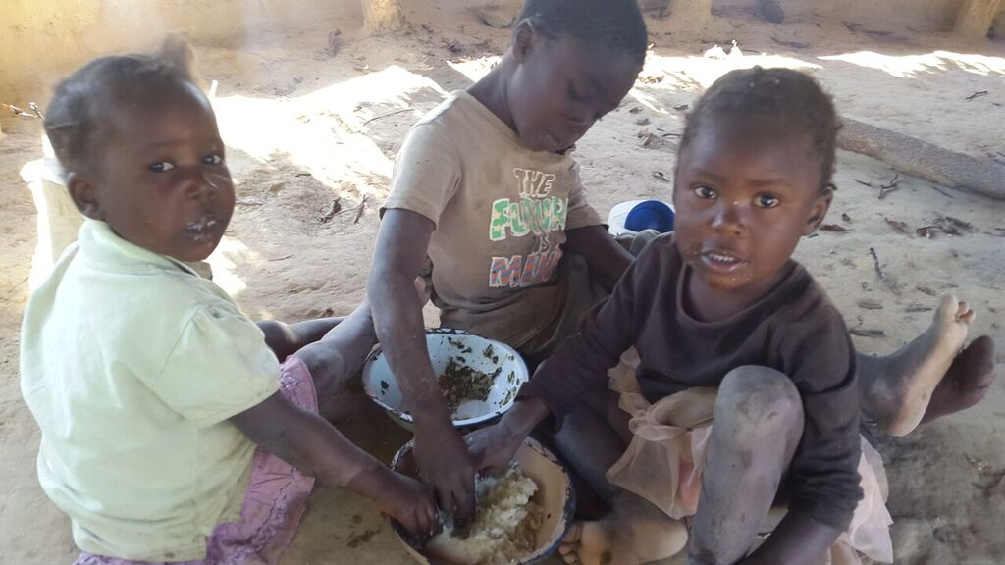
Thankyou

Slide 22
What interventions are currently in place, and what do they want to achieve
Nutrition
SUN 1000 critical days
Agricultural Productivity and Market Enhancement Program (APMEP
Rural Infrastructure and Water Development
Cashew Infrastructure Development (CIDP)
Zambia Water Resources Development Project
Irrigation
Smallholder Irrigation Promotion Program
Irrigation Development Support
Agribusiness
Smallholder Agribusiness promotion program (SAPP)
Agricultural Productivity and Market Enhancement Program (APMEP)
Food Reserve Agency (FRA)
Livestock
Livestock Infrastructure Development and Animal Health Project (LIDAHP)
Livestock Infrastructure Support Project (LISP)
Enhanced Sustainable Livestock Investment Program (E-SLIP)
Production and Productivity
Smallholder Productivity Promotion Program(S3P)
Agricultural Productivity Program for Southern Africa (APPSA)

Slide 23
Current Interventions

Slide 24
Research Questions
What interventions are currently in place, and what do they want to achieve
Who are the custodians of the interventions?
Who is funding the intervention?
What are the concerns and bottle necks around the ongoing interventions?

