Slide 1
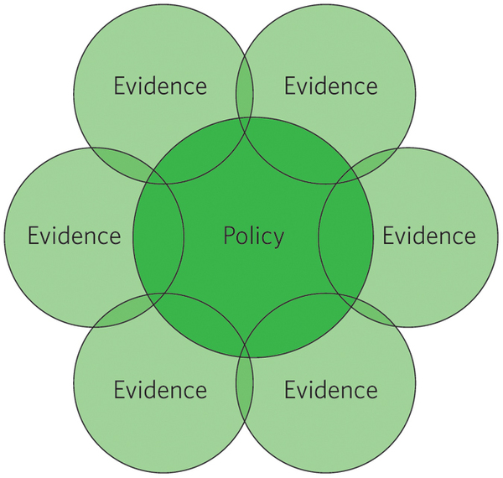
Enhancing the link between evidence and policy-making in Zambia’s Agricultural Sector
By
Antony Chapoto, PhD
Presented at the Policy Dialogue on
Food and Nutrition in Zambia.
Government Complex, Lusaka, 8th December 2015.
Indaba Agricultural Policy Research Institute

Slide 2
Presentation Outline
What is evidence-based policy-making?
Why is it important?
Evidence based-policy making in Zambia
How do we improve the status quo?
Some questions for discussion

Slide 3
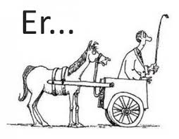
The Challenge?
Implementation of costly but Ineffective programs
Disregarding evidence in decision making
Limited commitment to try out alternative policies
Conventional wisdom usually rules the day

Slide 4
Evidence-Based Policy-Making
“Evidence-based policy helps people make well-informed decisions about policies, programmes and projects by putting the best available evidence from research at the heart of policy development and implementation. (Davies, P.T., 1999)
Research Evidence
Lobbyists &
Pressure Groups
Resources
Agric. and Nutrition Policies
Habits &
Tradition
Price Dilemma
Experience &
Expertise
Politics

Slide 5
Why Evidence-Based Policy-Making?
Effectiveness - ensure we do more good than harm
Efficiency - use scarce public resources to maximum effect
Service orientation - meet citizen’s needs/expectations
Accountability - transparency of what is done and why
Democracy - enhance the democratic process
Trust - help ensure trust in government and public services

Slide 6
Evidence-Based Policy-Making in Zambia
Poverty
Development outcomes depend on the quality of policies adopted.
Quality of policies depends on the evidence on what works and what doesn’t.
A dynamic economic environment and scarce resources
Implication is that sound agricultural policies based on evidence will be required to address development challenges.
Malnutrition
Food Insecurity

Slide 7
Where we want to go
Evidence-Based Policy-Making in Zambia
Status Quo
Evidence demand constrained country
Limited evidence use.
Improved quality and availability of evidence.
Poor development outcomes.
Virtuous circle country
Improved evidence demand.
Improved quality and availability of evidence.
Improved development outcomes.

Slide 8
Agricultural Policies and Programs in Zambia
Agricultural policies and programs in Zambia are often inadequately informed by research-based evidence due to:
information gaps,
the need for speedy responses,
political expediency
lack of transparency
the fact that policy makers are rarely scientists and
rent seeking behaviour by a privileged few.

Slide 9
Lots of Data
Limited use of an Enormous Amount of Data for Evidence Generation.
Costly datasets are used for basic descriptive analysis
Generating more evidence from these could help decision making.
Challenge to researchers and technical experts in government
.
Crop Forecast Surveys
Post Harvest Surveys
Living conditions Monitoring Surveys
Rural Agricultural Livelihood Surveys,
Demographic Health Surveys, etc.

Slide 10
Evidence-Based Policy in Zambia Some Positive Examples
Switch to bio-fortification as a main avenue for combating Vitamin A deficiency. Sugar fortification reduces the problem modestly.
Shift from giving 8*50Kg bags of fertilizer to 4*50Kg bags
The E-voucher Pilot: 13 districts 2015/16 Ag. Season
Agriculture & Nutrition

Slide 11
Improving the Status Quo

Slide 12
How can we change the status quo?
Government policy makers or Technical staff
Researchers

Slide 13
How can we change the status quo?
Government policy makers or Technical staff
Researchers
Include senior decision-makers from policy making institutions in the early stages of research designs to ensure early buy-ins.

Slide 14
Enhancing evidence-based policy
Communicate research effectively to decision makers and their technical staff

Slide 15
Enhancing evidence-based policy
Continuous dialogue between senior decision-makers, government technical staff and researchers.

Slide 16
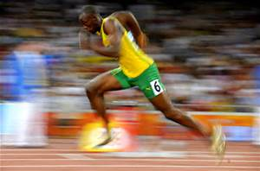
Enhancing evidence-based policy
Increase the speed with which evidence is generated.

Slide 17
Enhancing evidence-based policy
Capacity training of key policy makers and their support staff

Slide 18
Enhancing evidence-based policy
A long term solution is to instill a culture of inquiry in the population the education system.
Ordinary citizens need to demand evidence-based policy

Slide 19
Policy making is complex
Policy processes are complex (not linear)
simply presenting information to policy-makers and expecting them to act upon it is very unlikely to work.
Policy processes have various stages and each may take time to complete.
So our strategies must be fluid.

Slide 20
What do we want to see?
Zero Post harvest Losses
Breadbasket of the Region
Evidence-based Policies
Diversified Agricultural Sector
Lower rural poverty rates
High agricultural GDP growth
Hunger Free Zambia
Zero malnutrition
Private sector led agricultural growth
Open Borders

Slide 21
Some questions for discussion
Why is there less appetite for evidence based policy making in Zambia?
Are decision-makers aware of the existing evidence?
How relevant is the evidence to decision-makers?
How can we increase the appetite for evidence based policy making in Zambia?

Slide 22
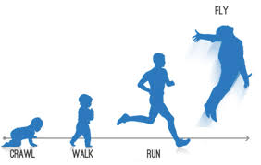
Thank You

